Slide 1


What helps us bounce back?
Indian Institute of Technology-Kharagpur
Manas K Mandal

Slide 2
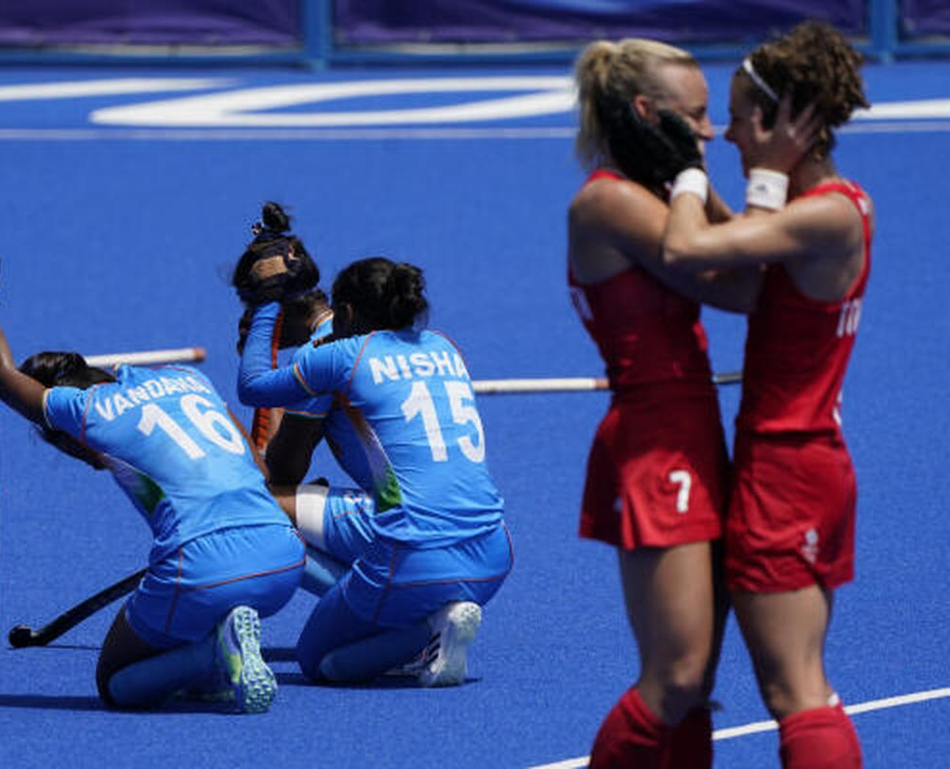
Failure types
Indian Institute of Technology-Kharagpur
Abject failure: loosing something essential (health, livelihood)
Glorious failure: giving all but failed ultimately
Common failure: average everyday failure
Predicted failure: new idea trying out or with lot of goals
Unintelligent failure: making unnecessary effort

Slide 3

Failure: some more types
Indian Institute of Technology-Kharagpur
Catastrophic failure: extremely negative with broad impact
Passive failure: as a function of inaction as opposed to action
Creeping failure: looks like a success but revealed like a failure
Historical failure: in the past
Preventable failure: possibility in the future

Slide 4
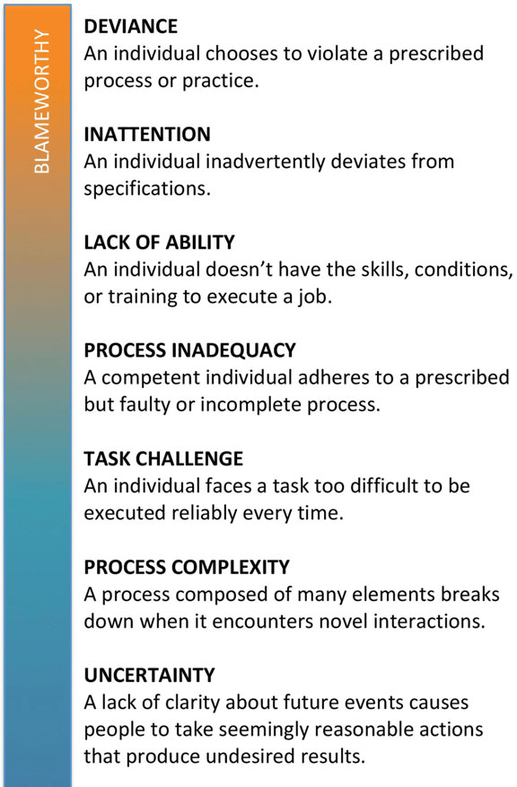
Reasons for failure (Edmondson, 2011)
Indian Institute of Technology-Kharagpur
Deviance: violating a prescribed norm
Inattention: deviating from specification
Lack of ability: lack of skill or training
Process inadequacy: skill available but process incomplete
Process complexity: unknown interactions within process
Task challenge: too difficult to be executed
Uncertainty: lack of clarity about future events

Slide 5

Fear of Failure
Indian Institute of Technology-Kharagpur
You fear to do something new that involves risk.
Instead of looking at the success rate, you count the chances of failure
Out of fear, you are losing interest in ventures that used to excite you earlier
You doubt your ability to succeed
You constantly worry about people’s opinions or what they think.
The situation is always do-or-die for you

Slide 6
Why failure is important?
Indian Institute of Technology-Kharagpur
We learn more from our failures than from our successes
We find out what doesn't work so that we can adjust our future attempts
In a safe learning environment, we improve skills without the fear of negative consequences

Slide 7

Resilience
Indian Institute of Technology-Kharagpur
…a process of adapting well in face of adversity,
trauma, threat or tragedy
…an ordinary ‘magic’ & not an extra-ordinary behavior
…they also experience difficulty or distress but behave
differently that can be developed in anyone

Slide 8
Resilience in sports
Indian Institute of Technology-Kharagpur
The ability for athletes to advance despite adversity such as injuries, lost competitions, change of circumstances and other stressors at home and with themselves

Slide 9

The resilient person…
Indian Institute of Technology-Kharagpur
They either win or learn
They understand that all failures are temporary
Their anger is paired with determined action
They identify themselves as survivors & not a victim
They find meaningfulness in every effort

Slide 10
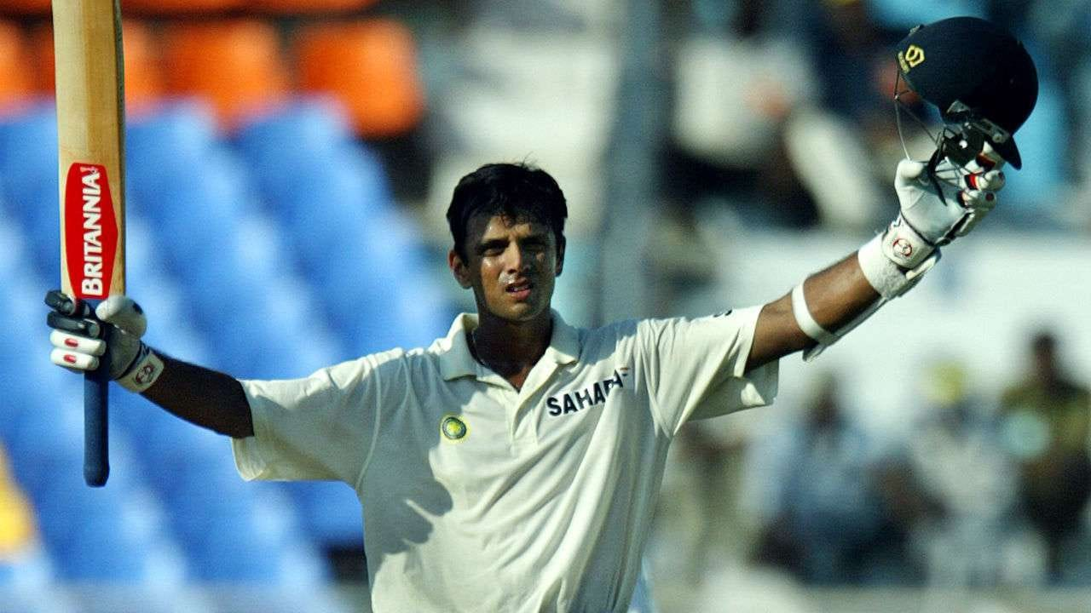
The resilient person…
Indian Institute of Technology-Kharagpur
They self regulate & set boundaries [believe that they can change the situation, rather than assuming that it is fixed]
They view stress as a way to get stronger [they continue to see opportunity in all challenges]
They cultivate self-awareness [remain flexible & do not develop emotional glaciers, just to appear strong]

Slide 11
The resilient person…
Indian Institute of Technology-Kharagpur
They practice acceptance [witness & experience the full range of emotions & absorb lessons, only to bounce back]
They consider possibilities [look at in a different way that they were not considering; maintain a positive outlook]
They have strong internal locus of control [attribute failure to his/her own mistake instead of blaming others]

Slide 12

Indian Institute of Technology-Kharagpur
Why does failure hurt so much…
Comparison with others (comparison with self brings improvement, comparison with others brings discontent)
Overemphasis on best ideas or on success only in mind (vs having alternatives)
Getting stuck in comfort zone (this is a beautiful zone, but nothing grows there)
Living always in past or future (out of 60,000 thoughts that we run each day, 95% are repeats)

Slide 13

…why do we fail?
Indian Institute of Technology-Kharagpur
Arrogance: It happens as one hallucinates about his own greatness
Comfort: It sabotages greatness
Luck: Failure occurs in pure luck but not in skill-based luck
Poor self-regulation: Lack of control on energy expenditure
Shift in focus: A shift from ‘thinking big’ to doing ‘micro-management’

Slide 14
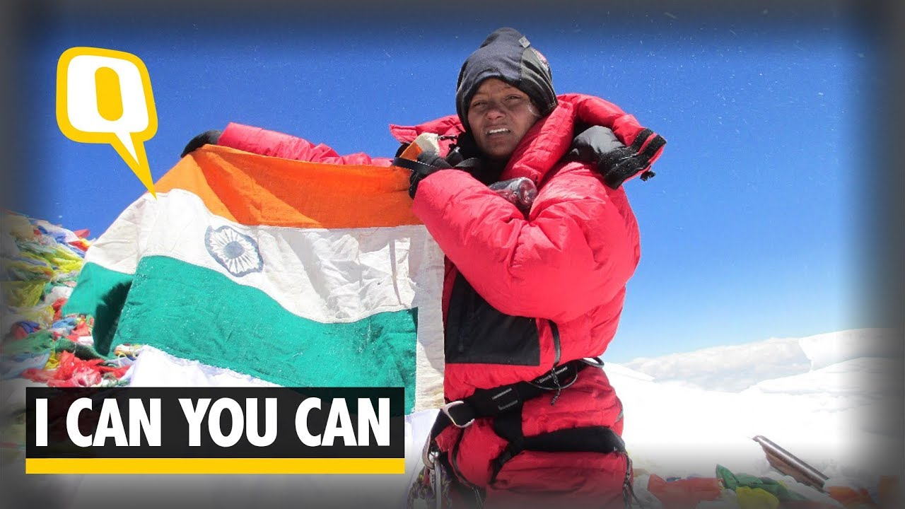
Nurturing resilience…
Indian Institute of Technology-Kharagpur
Accept failure a manageable process – promote growth later
Nurture mindset first – enrich mind later
Develop the desire to bring change – restore equilibrium later
Implement new skill – rely on old habits later
Align with ‘future’ first – driven by the ‘past’ later
Be ‘true’ to yourself – look for ‘success’ later

Slide 15
How to develop resilience in sports
Indian Institute of Technology-Kharagpur
Performance under pressure (big day)
Adaptability to unexpected situations (like opponent strategies)
Recovery from setbacks (like after conceding a goal)
Sustained motivation (passion more than purpose)
Confidence & self-belief (positive self-image)
Emotional regulation (during disappointment)
Focus & concentration (tune out distractions)
Life beyond sports

Slide 16
How to bounce back from failure
Indian Institute of Technology-Kharagpur
Fail fast (work quickly through the feelings & decide what have you learnt)
Accept failure as a natural process (learn from it and allow it to destroy you)
Realize failure not a personal defeat (context plays a big role)
Develop an attitude of gratitude when it comes to failure
Keep going after the failure

Slide 17

Need for resilience in daily life…
Indian Institute of Technology-Kharagpur
When there are failures in my personal life
When I feel being criticized personally
When I am challenged in my performance
When I have conflicts (life vs career, head vs heart)
When the nature of work is outside my comfort zone
When my ability to work stretches to my limits
When I am managing difficult relationship

Slide 18
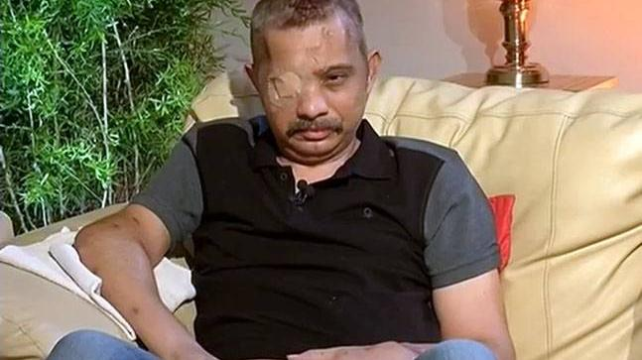
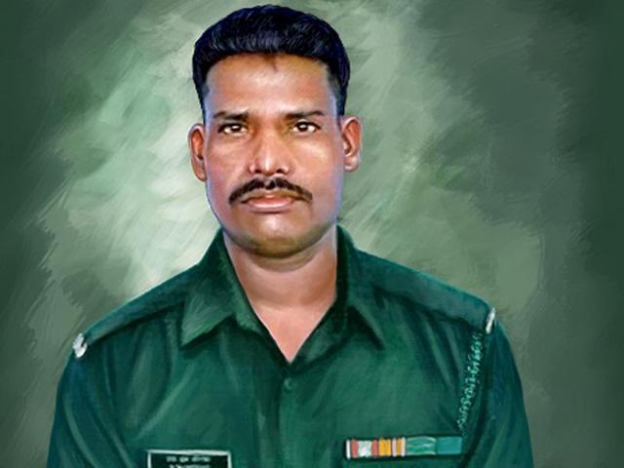
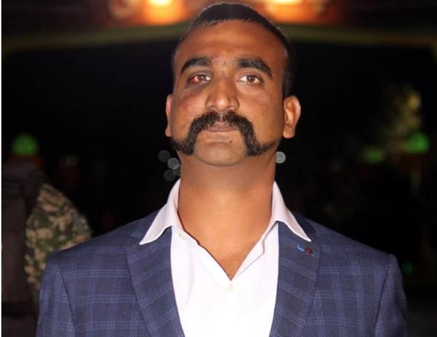
Indian Institute of Technology-Kharagpur
Chetan Chettah
Shot by terrorists with nine bullets
Ready to return to duty – CRPF
Hanamanthappa Koppad
Buried under 25 feet snow, survived six days under it
Died only after reaching hospital
Abhinandan Vartaman
Under captivity in Pakistan
Chose to return to his base in Srinagar
instead of visiting home

Slide 19
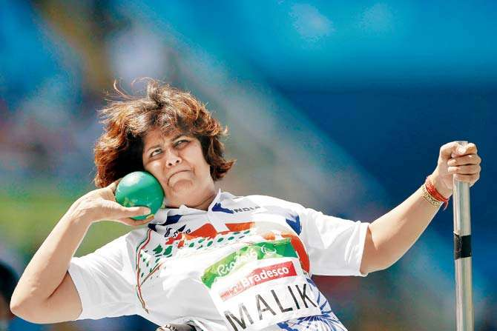
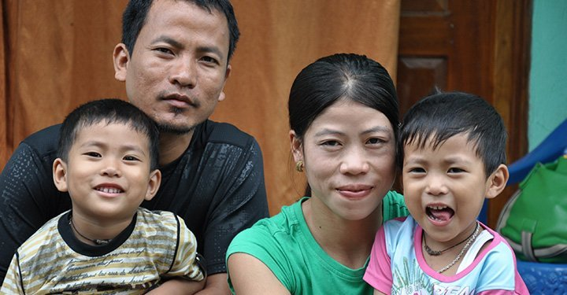
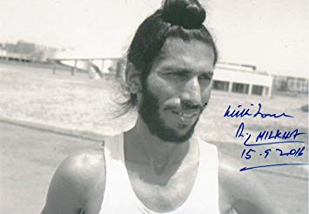
Indian Institute of Technology-Kharagpur
Spinal tumor, paralyzed waist down
18 international medal, Paralympics medal
The most successful boxer in the history
A great mother too
Indian’s most revered Olympian
a gallant loser in 1960 Rome Olympics

Slide 20
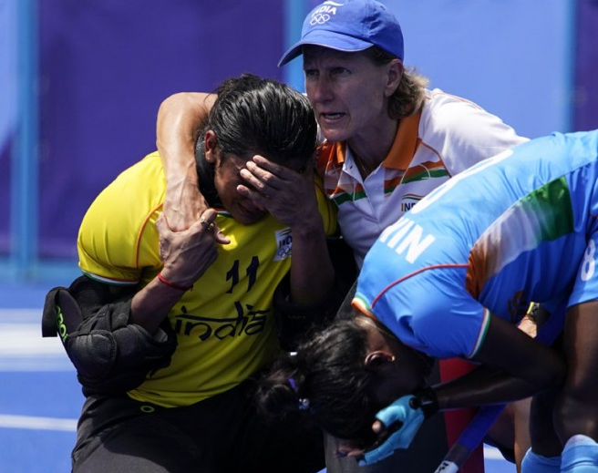

Indian Institute of Technology-Kharagpur

